Slide 1


Palm Sunday resources for schools
Dr Audrey Statham
Social Responsibilities Committee – Anglican Diocese of Melbourne

Slide 2
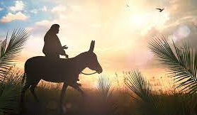
Palm Sunday
The Gospel stories in the Christian New Testament (NT) of the entry of Jesus to Jerusalem on a donkey on what is now called Palm Sunday, are well known.

Slide 3

Lesson one
The New Testament books of Matthew, Mark, Luke and John describe how crowds of people travelling into Jerusalem for the Jewish Passover festival responded to Jesus when they saw him riding a donkey into the city. It’s the only story about Jesus in all 4 Gospels.

Slide 4
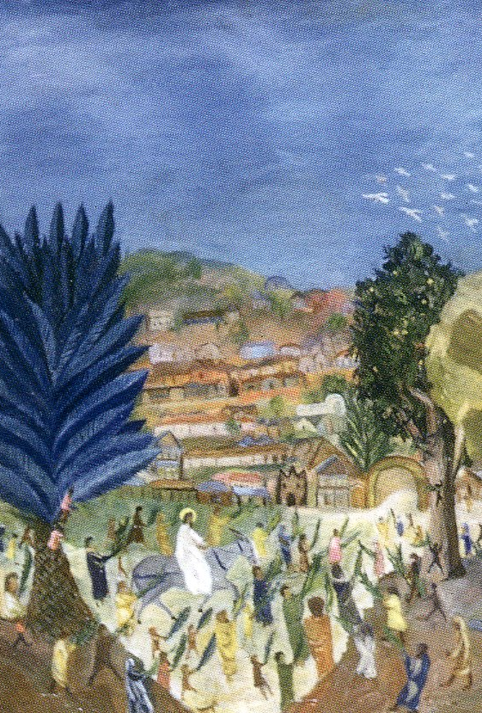
The Palm Sunday story
People gathered tree branches to wave and spread at the feet of Jesus along with their cloaks (John mentions palm leaves) (Mk 11:7-8; Mt 21:8; Lk 19:35-36; Jn 12:13)
The crowds also shouted, ‘Hosanna to the Son of David! Blessed is he who comes in the name of the Lord! Hosanna in the highest heaven!’ (Mk 11:10; Mt 21:9; Jn 12:13)

Slide 5
sequence of events*
Jesus and his disciples arrive at a place near Jerusalem and arrange to borrow a donkey
Jesus enters Jerusalem riding on the donkey and is greeted by crowds going into the city to celebrate the Passover festival
When Jesus enters the city, he enters the Temple and drives out the money changers, and then leaves the city for Bethany
He then returns to the Temple and for that week gives his most provocative teaching against the religious leaders of the day (the ‘Seven Woes’ (Mt 23))
On Friday Jesus is crucified.
*The other gospels have a slightly different sequence to Matthew’s.

Slide 6
Tell or enact Palm Sunday – Mt 21:1-11
Read aloud Matthew’s account of Jesus’ riding on a donkey to Jerusalem on the next slide
For younger primary school children, this could be read out by the teacher seated with the children in a circle on the floor
Older primary school children could act out the Palm Sunday story whilst speaking different parts (either as part of the R.E. lesson or for a school assembly – see Slide 10)
Secondary students could volunteer to read the story aloud: either one or two students or more speaking the different parts (see Slide10).

Slide 7
MATT 21:1-11
1 When they had approached Jerusalem and had come to Bethphage, at the Mount of Olives, Jesus then sent two disciples, 2 saying to them, “Go into the village opposite you, and immediately you will find a donkey tied there and a colt with it. Untie them and bring them to Me. 3 And if anyone says anything to you, you shall say, ‘The Lord needs them,’ and he will send them on immediately.” 4 Now this took place so that what was spoken through the prophet would be fulfilled:
5 “Say to the daughter of Zion, ‘Behold your King is coming to you, Humble, and mounted on a donkey, Even on a colt, the foal of a donkey.’”
6 The disciples went and did just as Jesus had instructed them, 7 and brought the donkey and the colt, and laid their cloaks on them; and He sat on the cloaks. 8 Most of the crowd spread their cloaks on the road, and others were cutting branches from the trees and spreading them on the road. 9 Now the crowds going ahead of Him, and those who followed, were shouting,
“Hosanna to the Son of David; Blessed is the One who comes in the name of the Lord; Hosanna in the highest!”
10 When He had entered Jerusalem, all the city was stirred, saying, “Who is this?” 11 And the crowds were saying, “This is Jesus the prophet, from Nazareth in Galilee.”

Slide 8
What does ‘hosanna’ mean?
Slides 8-9 can be used for younger primary students
On Palm Sunday, Christians often say and hear the word “Hosanna”, but what does that actually mean?
It’s much more than just a simple cheer like, “Hooray!” or “Woohoo!”
The word Hosanna tells us something about who Jesus is.
Chat to another student about what you think ‘Hosanna’ might mean (what do you think the people meant when they shouted this on Palm Sunday?). It’s okay to just take a guess or say something silly!
In your pairs, draw a picture together of what the word ‘Hosanna’ could mean.

Slide 9
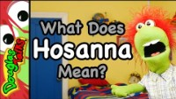
What does ‘hosanna’* mean?
Slides 8-9 can be used for younger primary students
Watch this video
In your pairs, chat about what Douglas the puppet says ‘Hosanna’ means
Draw another picture together of what you think ‘Hosanna’ means after listening to Douglas
Show your drawings to another pair of students
Explain to each other what you think the word ‘Hosanna’ tells us about who Jesus is
Source: https://douglastalks.com/what-does-hosanna-mean-palm-sunday-lesson-for-kids/
* Please see Slide 30 for a more detailed explanation of the two words that have been translated into Greek as “Hosanna”.

Slide 10
Acting out Palm Sunday
This slide (Slide 10) can be used for older primary students
Ask the students to decide amongst themselves who will take the following roles:
The narrator of Matthew’s Gospel
Jesus
The prophet Zachariah
The disciples (non-speaking roles)
The crowds (all the remaining students)
Find or make props: palm leaves and coats (or jumpers) & a donkey!
If you have time, make costumes
Teacher organizes the students to proceed from one side of the classroom to the other, enacting the story of Jesus traveling with his disciples from the Mount of Olives into Jerusalem. Or nominate a student to be the director.

Slide 11
2 questions: Palm Sunday
The remaining slides can be used or adapted for older primary students & secondary students
It’s possible to ask many different questions about the meaning of the Palm Sunday story. Here we’ll just focus on two.
Why did Jesus choose to do what he did in the Palm Sunday story?
Why did the crowds of people greet Jesus in the way they did?
To dig into these questions, we need to inquire into:
The background of Palm Sunday: the Roman empire
The Hebrew Bible in the Palm Sunday story

Slide 12
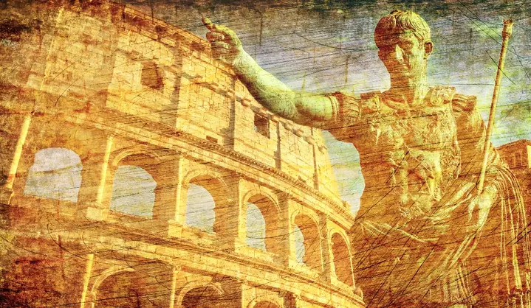
political context: roman empire
In Jesus’ day, Judea was a province of the Roman Empire.
At the time of Palm Sunday, the Roman official, Pontius Pilate, was military governor (26-36 CE) of Judea.
The Jewish people felt oppressed and longed to be free from Roman rule.

Slide 13
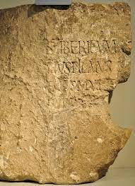
Pilate the roman governor: Archeological evidence
A limestone block (82cm wide by 68cm high) was found in 1961engraved with the name ‘Pontius Pilate’ and stating his role as ‘prefect of Judea’.
This provides concrete archeological evidence that Pontius Pilate existed and was the governor of Judea as the Bible says.

Slide 14
Pilate the roman governor
Rome was on guard against any sign of rebellion against their rule.
Pilate came to Jerusalem with his army only during the important festivals to clamp down on unrest or uprisings when the large crowds sparked nationalistic activism.
The fact that the most important Jewish festival Passover, which commemorates the liberation of the Hebrew people from a foreign ruler when they were slaves in Egypt, was approaching would have heightened the tensions between Roman authorities and the Jewish people in Jerusalem on the day that Jesus entered the city on a donkey.
Source: https://www.britannica.com/biography/Jesus/Jewish-Palestine-at-the-time-of-Jesus

Slide 15
Caiaphas the high priest
For the rest of the year, Pilate relied on local Jewish leaders to govern Judea on a day-to-day basis.
Jewish leaders had a close relationship with Roman authorities.
The high priest during Jesus’ public career was Caiaphas who was tasked with making sure taxes were paid to Rome and maintaining order.

Slide 16
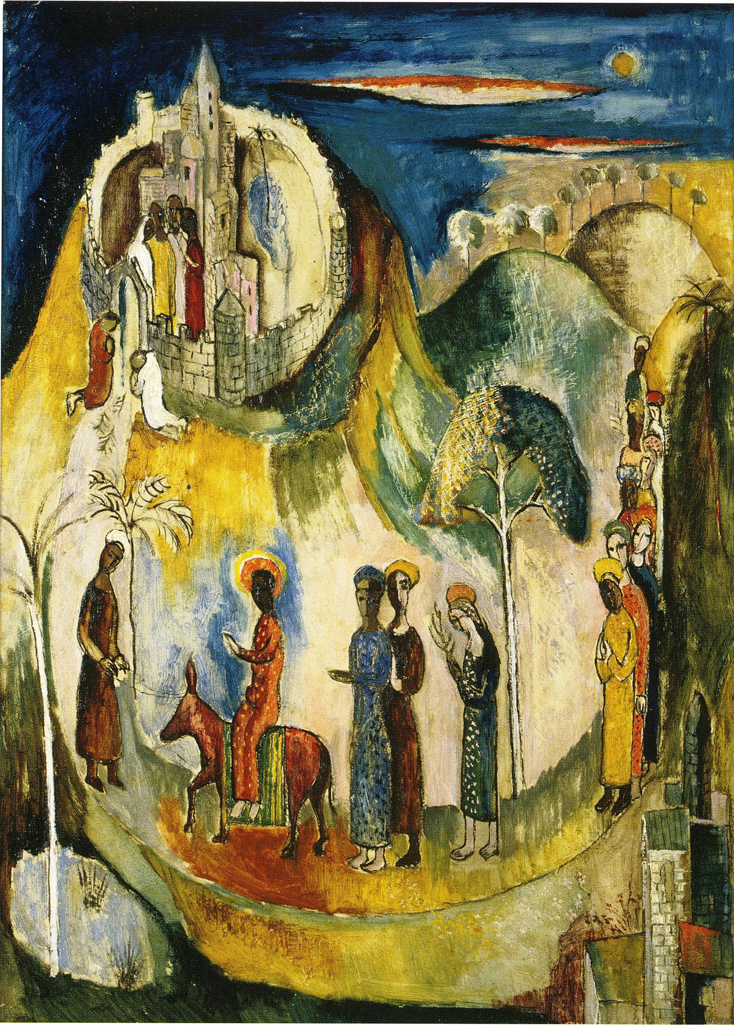
Palm Sunday: a dangerous environment
Clearly, Jesus was confronted by dangers on several fronts: from Rome, from the religious leaders of his community and from not meeting ordinary Jewish expectations.
Roman authorities might think he was a rebel stirring up an uprising against the rule of the Roman Empire in their country.

Slide 17
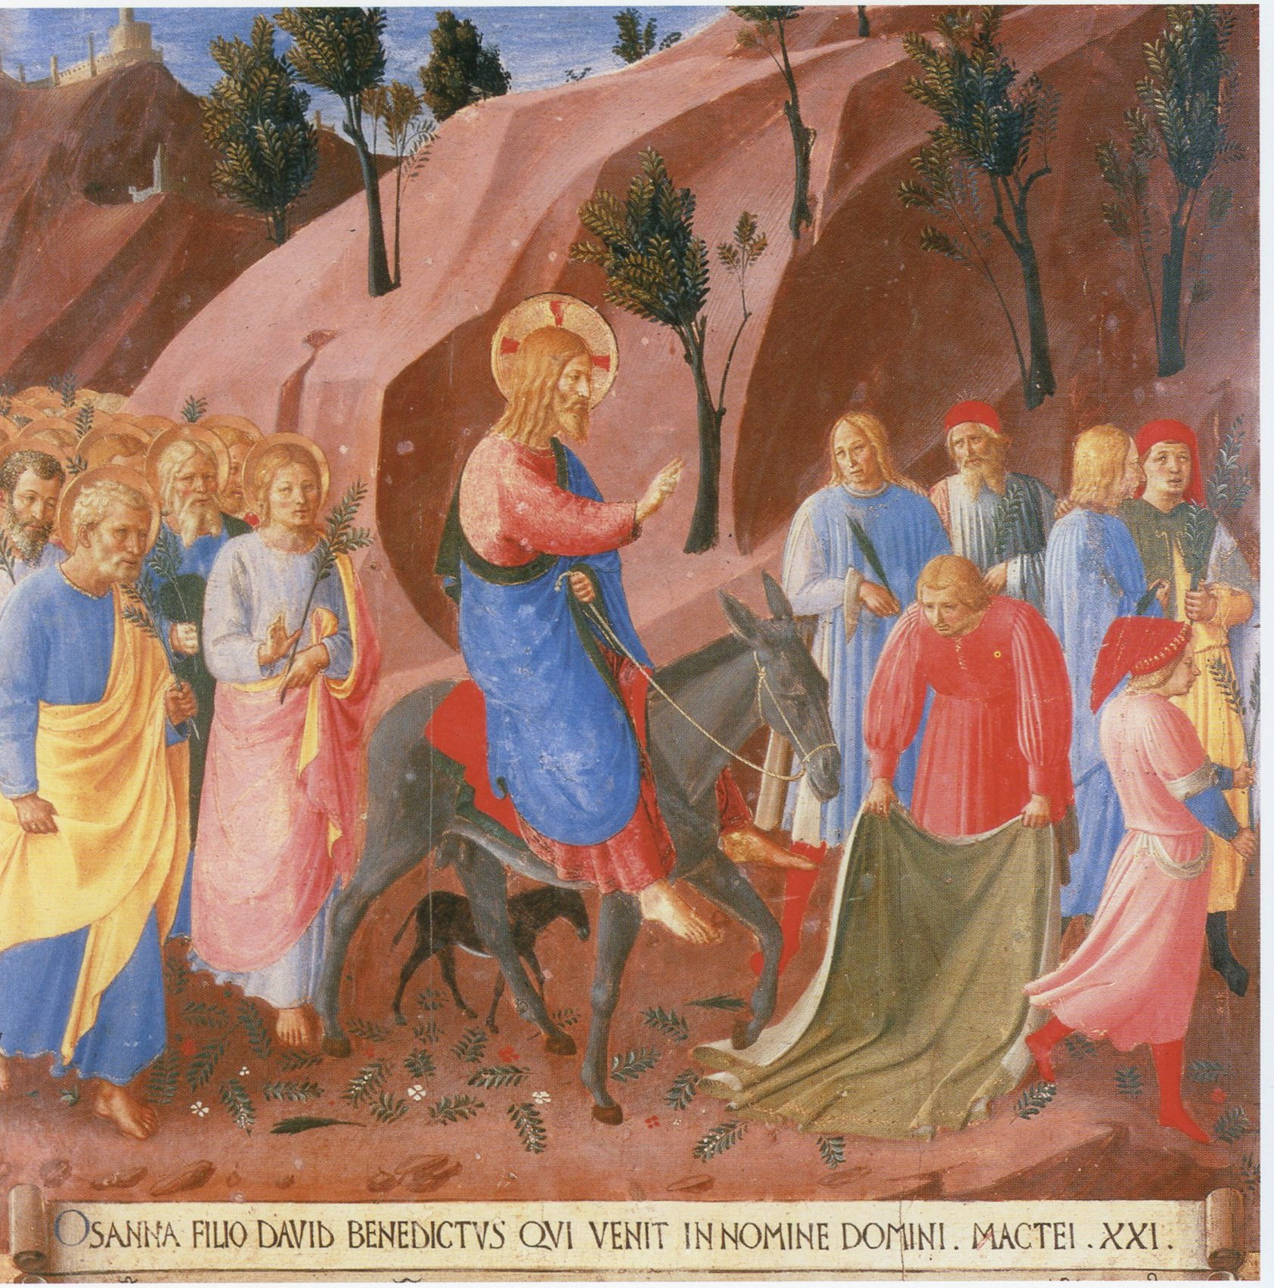
Palm Sunday: a dangerous environment
Religious leaders of the Jewish community might think Jesus was a threat to Rome’s tolerance for Jewish religious institutions.
The Jewish population were longing to be set free from the Roman rule by a military leader: a warrior king who would overthrow Rome. But Jesus’ vision went against the grain of these ideas.

Slide 18
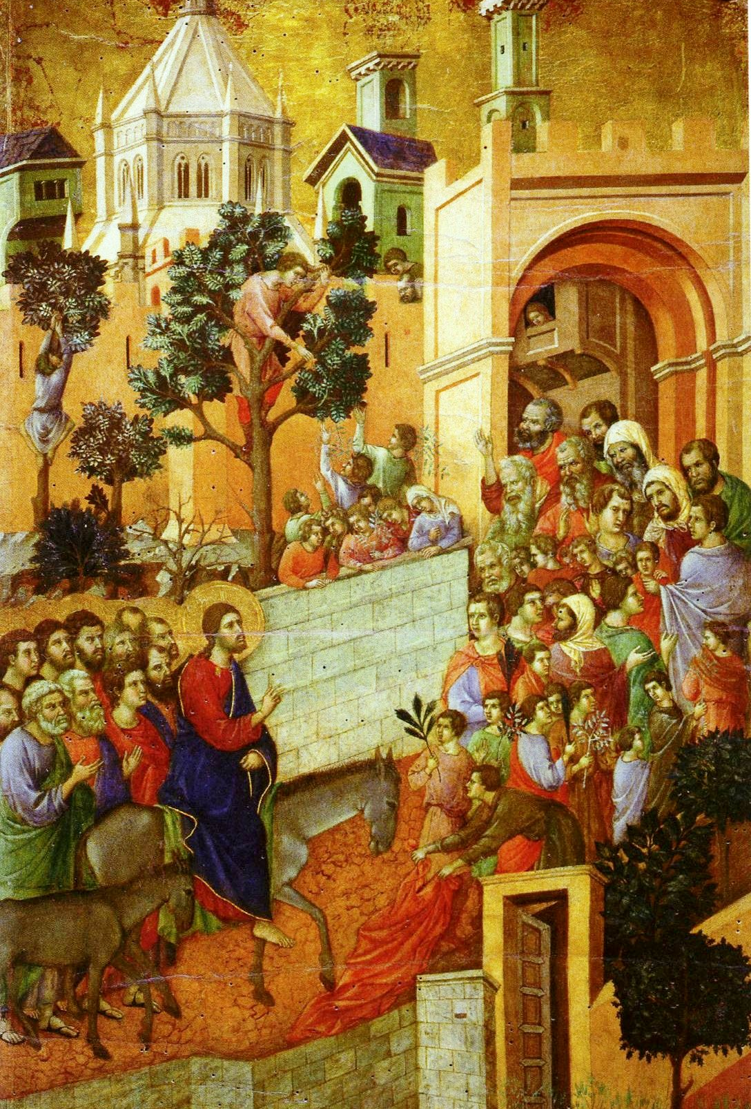
Palm Sunday: a dangerous environment
Jesus didn’t just unthinkingly accept and passively accommodate to the political and religious institutions and status quo.
Jesus didn’t choose to lead a coup against Rome in line with the hopes of ordinary Jewish people at that time.

Slide 19
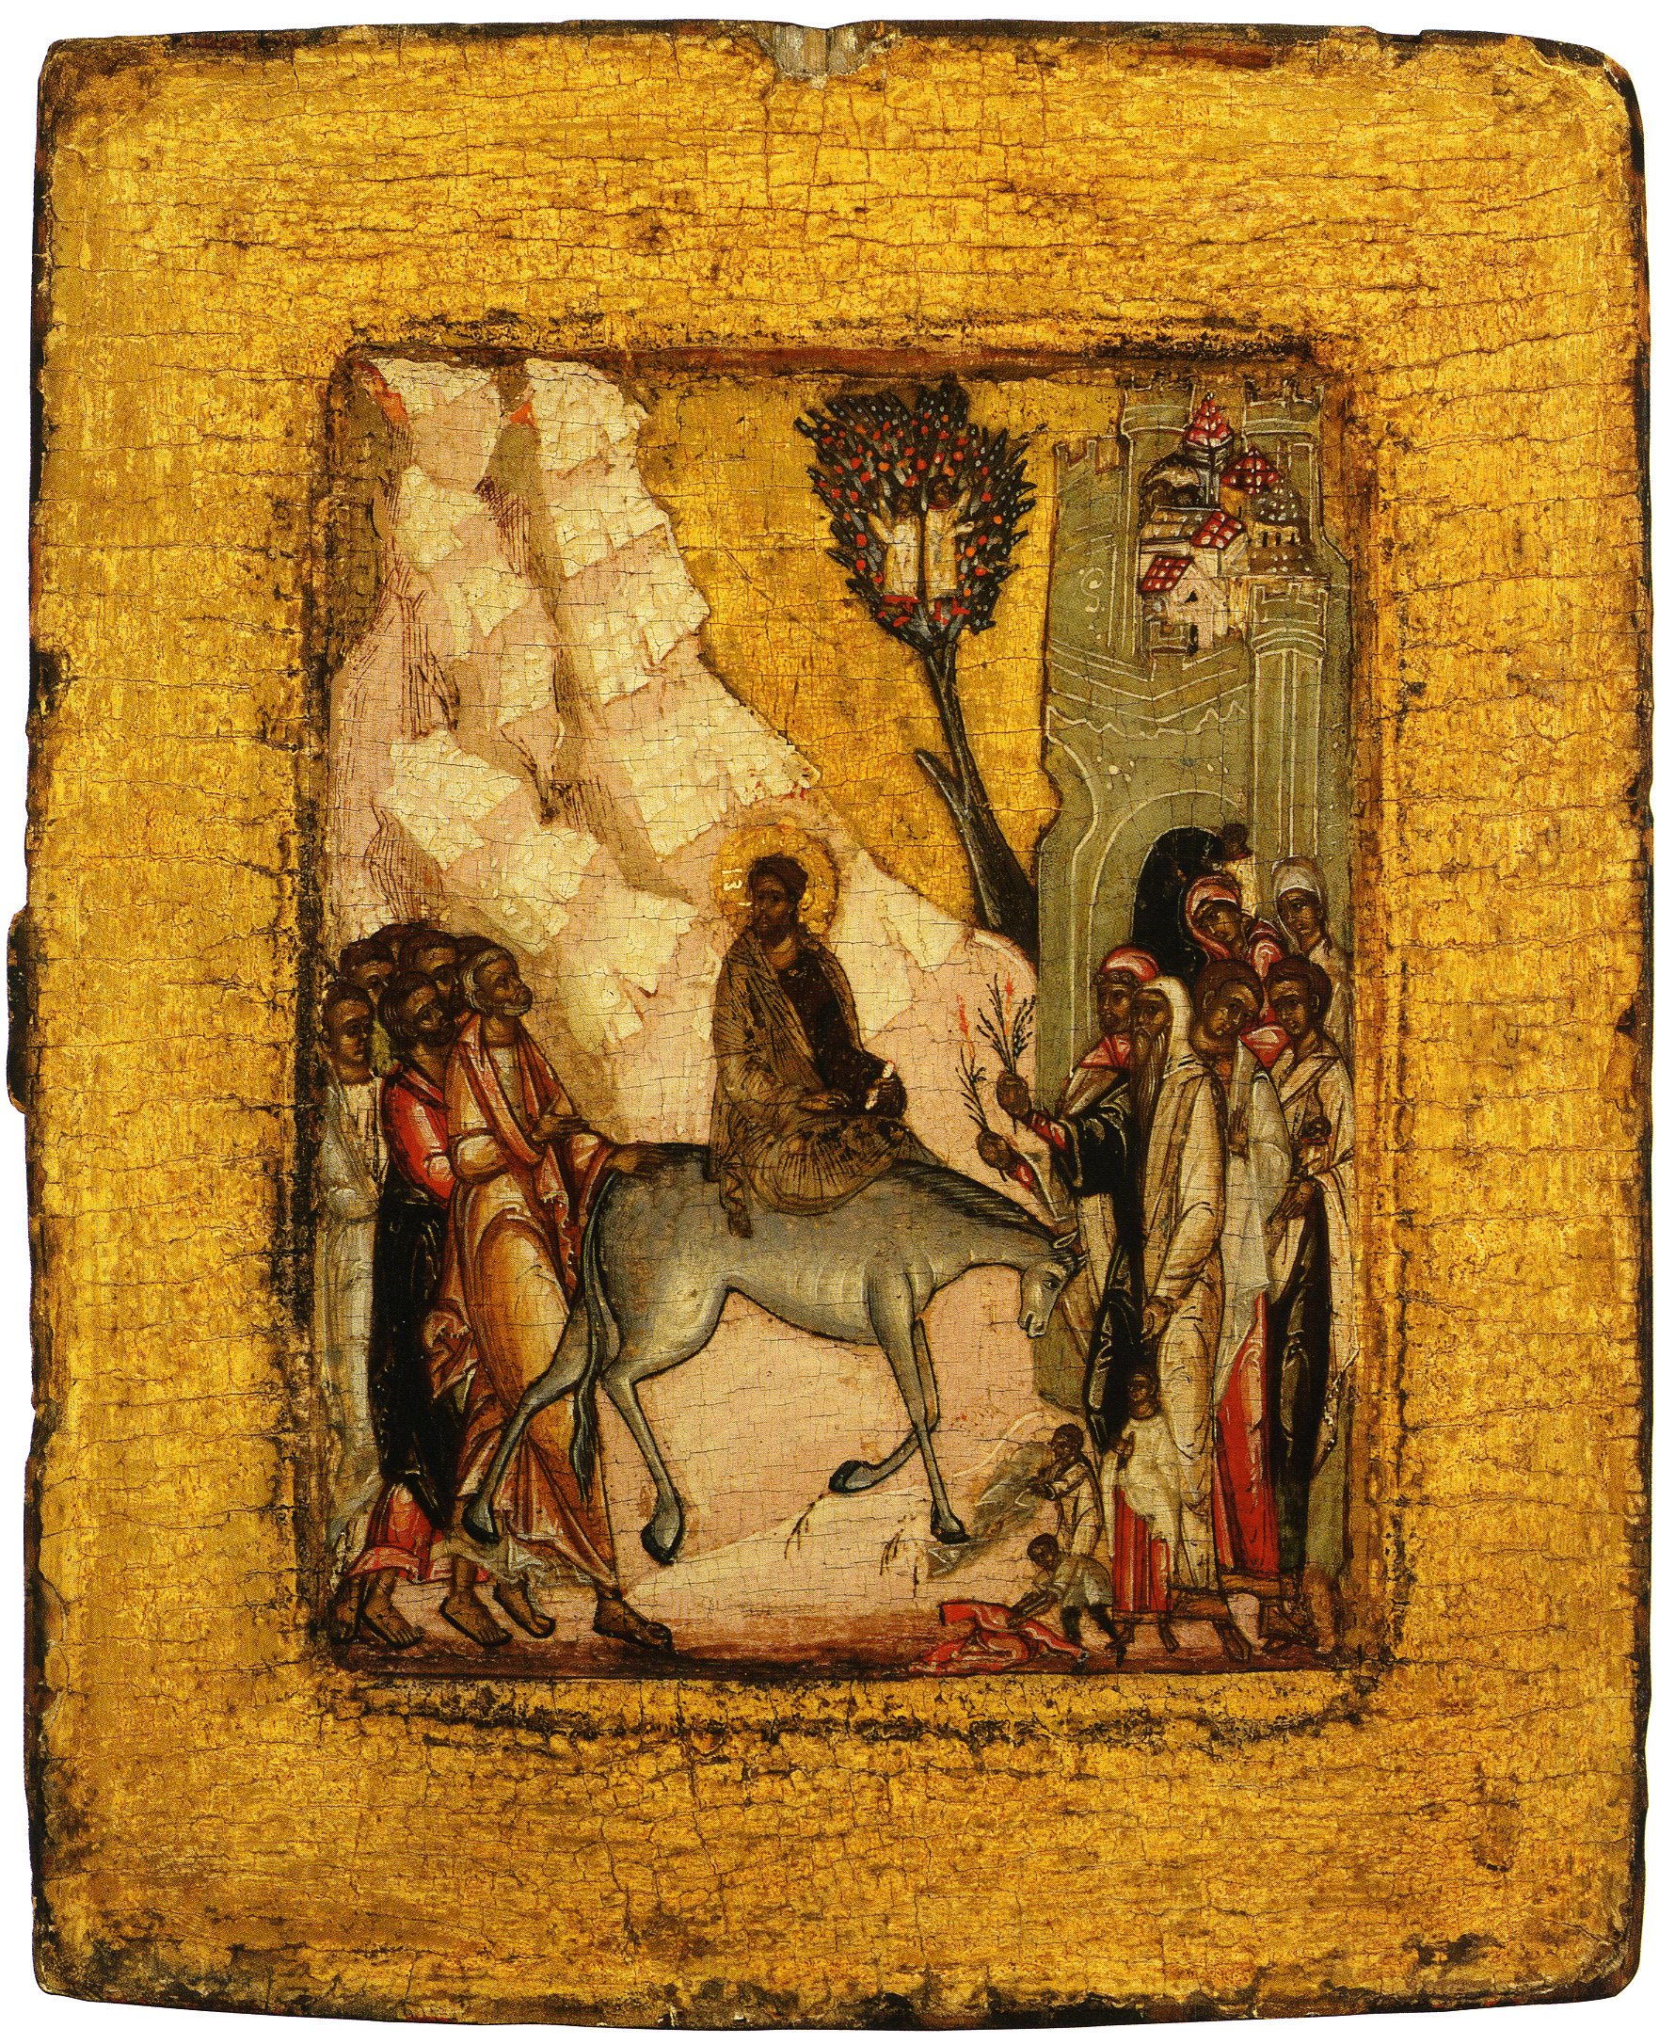
Palm Sunday: a dangerous environment
Instead, Jesus chose to dissent, disrupt and challenge Jewish religious traditions, the expectations of ordinary Jews and even the Roman empire by planning and doing what he did.
Why do you think he did this? (Ask students to think-pair-share with the person next to them, write down their reflections and share with the class: 100-150 words).

Slide 20
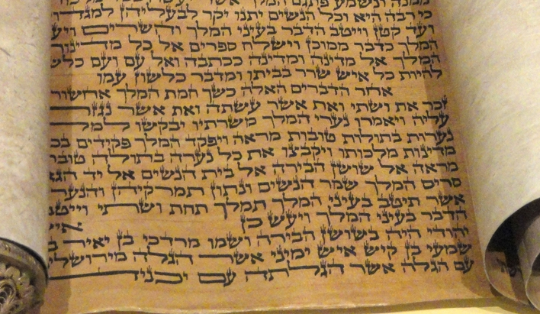
Lesson two: Hebrew bible & palm sunday
Two passages or verses from the Hebrew Bible (Christians refer to this as the Old Testament) are important for understanding what Jesus was doing and how people responded to him in the Palm Sunday story.
Specifically, Zechariah 9:9-10 and Psalm 118:25-26.

Slide 21
Hebrew BIBLE: two students to read the verses
9 Exult greatly, O daughter Zion! Shout for joy, O daughter Jerusalem! Behold: your king is coming to you, a just savior is he, Humble, and riding on a donkey, on a colt, the foal of a donkey.
10 He shall banish the chariot from Ephraim, and the horse from Jerusalem; The warrior’s bow will be banished, and he will proclaim peace to the nations. His dominion will be from sea to sea, and from the River to the ends of the earth.
25 Lord, grant salvation! [translated from Hebrew into Aramaic as ‘Hosanna’ in Matt 9] Lord, grant good fortune!
26 Blessed is he who comes in the name of the Lord. We bless you from the house of the Lord.
Psalm 118:25-26
Zechariah 9:9-10

Slide 22
Hebrew bible
On your own, read through the verses silently
Reflect silently on what the verses might mean
Is there a word or idea or image that is especially meaningful for you?
Is there anything you find difficult to understand or relate to?
Is there anything you want to find out more about?
Write down about 100-150 words that summarise your reflections.

Slide 23
Zechariah 9:9-10 – What kind of king?
Attributes of the ‘salvific’ or saving figure envisaged by Zechariah include that the one who will come will …
Suggested activity (5 mins):
Include a link to a Padlet or shared Google doc and ask students to write down different attributes

Slide 24
Zechariah 9:9-10 – What kind of king?
Attributes of the ‘salvific’ or saving figure envisaged by Zechariah include that the one who will come will …
be a royal figure, a king
be just
be a humble leader (rather than riding on a horse as distinguished persons at that time would do, the mount of this king would be a donkey which people of low rank rode)
bring about an end to war (again, the donkey is a direct denial of a horse which was a military animal)
bring about peace by non-military means through some sort of divine intervention
rule over all the nations of the world

Slide 25
Who was Zechariah’s intended audience?
Zechariah lived in 6th century BCE during the reign of Darius the Great, the Persian King who defeated Alexander the Great.
Zechariah addressed people who had returned to Jerusalem from their around 70-year exile in Babylon as well as those who had remained in Jerusalem after the city was conquered in 587/586 BCE.

Slide 26
Who was Zechariah’s intended audience?
A concern of Zechariah was to motivate people to rebuild the temple in Jerusalem which had been destroyed by the Babylonian army in 586 BCE.
In this context, Zechariah put forward his proclamation or expectation that there would be a great king who would enter Jerusalem riding on a donkey as part of God’s deliverance (e.g. saving) of the Jewish people.

Slide 27
Psalm 118 – how was it used?
Many scholars maintain that in ancient Jewish life Psalm 118 was used in liturgy.
Some believe it accompanied a procession of the king and the people entering the temple “with leafy branches up to … the altar” (verse 27).
Ezra 3:10-11suggests it may have been sung at the founding of the second temple after the Jewish people returned from exile and attributed it to “David king of Israel”.

Slide 28
Psalm 118 – how was it used?
The psalm may have been sung responsively whereby a leader (‘cantor’) alternates with a choir or congregation.
In Jesus’ time, Psalm 118 was the last of the 6 psalms (113-118) sung in connection with Passover reflecting on and giving thanks for God’s saving the Israelites, particularly from their bondage or slavery in Egypt.

Slide 29
Psalm 118:1-29
Verses 1–4 An invocation in the form of a litany giving thanks to God
5–9 the king or the psalmist (very likely speaking in the name of the community) describes how the people confidently asked for God’s help in times of trouble
10–14 when hostile peoples threatened its life.
15–18 God’s rescue is vividly described.
19–25 Then follows a possible dialogue at the Temple gates between the priests and the king/psalmist as the latter enters to offer the thanksgiving sacrifice.
26–27 Finally, the priests impart their blessing
28–29 and the King/psalmist sings in gratitude to God.
Source: https://www.biblegateway.com/passage/?search=Psalm%20118&version=NABRE Footnotes Psalm 118

Slide 30
Psalm 118:25
The verses leading up to 25-26, talk about a time when the people were delivered from trouble by God.
In the responsive singing, verse 25 may have been sung by the king/psalmist or congregation at the gates to the temple:
“Lord! Grant salvation!/Rescue us!* Lord, grant good fortune!”
*The words “Hosanna” translates the Aramaic word הושיעה נא‎ (hoshia' na), Aramaic being the language of the Jewish people in Jesus’s time. It is very similar to Hebrew, the language they spoke in previous times and in which most of the Hebrew Bible (Old Testament) is written.

Slide 31
Psalm 118:26
Verse 26 may have been sung as a blessing by the priests in response as the procession entered the temple and walked to the altar waving “leafy branches” (verse 27):
“Blessed is he who comes in the name of the Lord. We bless you from the house of the Lord.”

Slide 32
Hebrew bible in Palm Sunday story: brainstorm
In pairs, take a piece of paper and draw a vertical line down the middle
Brainstorm any similarities, connections or differences you see between the Hebrew Bible verses and the Palm Sunday story.
Reflect on: Where do the verses from Zechariah 9 and Psalm 118 ‘fit’ in the story (and vice versa)?
  Write down dot-points in the 2 columns
Write down a question that has been raised for you (one each; it can be about the Hebrew Bible verses or the Palm Sunday story or both!)

Slide 33
Palm Sunday: returning to the 2 questions
Now that we’ve inquired into the background of Palm Sunday and the use of the Hebrew Bible in the Palm Sunday story, let’s return to the two questions posed earlier:
Why did Jesus choose to do what he did on Palm Sunday?
Why did the crowds of people greet Jesus in the way they did?

Slide 34
Palm Sunday: what was Jesus doing & why?
Jesus carefully planned the events on Palm Sunday (see Mt 21:1-3).
He wanted to show the people that he was a salvific figure sent by God, the King of Israel.
However, he wasn’t the kind of warrior king that the people were expecting.
What he was doing was out of the ordinary and designed to draw attention to himself and to the claim he was making in the tradition of ‘prophetic signs’ in the Hebrew Bible (e.g., Ezekiel, Jeremiah, Isaiah to name only a few).

Slide 35
Palm Sunday: what was Jesus doing & why?
Jesus chose to show people that he was the kind of king that Zechariah 9:9-10 was expecting through the ‘sign’ of riding into Jerusalem on a donkey.
Jesus’ use of Zechariah was revolutionary and subversive of the political and religious status quo as well as the expectations of his countrymen.
Jesus would have known that he was setting into motion events that would most likely put him at odds with Roman authority, religious leaders and with the common people, leading to him being arrested and put to death.

Slide 36
Palm Sunday: how did people respond & why?
People recognized the reference that Jesus was making to Zechariah and understood the claim he was making, to be their king.
In response, the people gave Jesus a royal accolade that drew on Psalm 118:
They shouted out two verses from a psalm attributed to King David about God saving his people, which was associated with a ritual procession of the king entering the temple
They waved tree branches and spread their cloaks at the feet of the donkey Jesus rode on.

Slide 37
Palm Sunday: how did people respond & why?
Like Jesus, the people drew on the Hebrew Bible in their response to him on Palm Sunday
It might have been a spontaneous pious response by someone in the crowd that was taken up by others (like a ‘chant’)
Or the followers of Jesus might have prearranged it with Jesus.
Regardless, both the people and Jesus’ followers misunderstood the kind of king that Jesus was claiming to be.

Slide 38
Palm Sunday: Jesus’ authentic response to his dangerous environment
Jesus acted the way he did because he had in mind a different type of king or leader and a different kind of liberation from oppression from the prevailing everyday understandings in the culture at the time.
In doing so, Jesus draw from a tradition in the Hebrew Bible and made these ideas and aspirations his own.

Slide 39
Palm Sunday: Jesus’ authentic response to his dangerous environment
On Palm Sunday Jesus committed to, courageously embodied and lived out to the bitter end his ideal of kingship and salvation.
He thereby found a way through what had up until then been an impenetrable impasse for all humanity and creation.

Slide 40
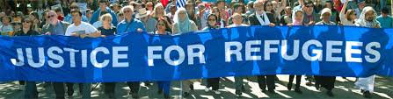
Walk for justice for refugees
Palm Sunday in Australia is a ‘sign’ that bears witness to the priority of compassion and to the call for justice for refugees and asylum seekers.
The Palm Sunday Walk for Justice for Refugees is a contemporary procession through city streets.
Some people will hold signs and banners, some will sing songs, some will call out for compassion, justice and peace in place of coercion.

Slide 41
Walk for justice for refugees
Some onlookers may pause to look for a moment as the procession passes by, and then go about their day.
Some will question what a group of concerned citizens, Christians and other people of faith can do to change Government policies and practices to be more humane, just and welcoming of refugees and people seeking asylum.

Slide 42
Walk for justice for refugees
As we reflect on the plight of refugees, forced to flee their homes and, for many, their homeland, we can see the terrible consequence of war and conflict, and military might.
Let us again turn our attention to the way of Jesus, Prince of Peace, and follow His example in committing to compassionate care for the most vulnerable in our global village.

Slide 43
What Justice for refugees means
> Permanent visas and family reunion for all refugees
> Fair and timely assessment of all claims for refugee status
> Health care, work rights, income support, and access to education for all those seeking asylum
> Releasing ALL refugees from detention
> Offering resettlement here for refugees still in PNG, on Nauru, and in Indonesia
> Ending offshore processing and detention
> Increasing the humanitarian intake of refugees
To download a leaflet that explains in more detail what Justice for Refugees means, click here

Slide 44
Palm Sunday Call for Faith communities to seek Justice for the vulnerable
The call to show loving kindness and care for our neighbours, to welcome the stranger, and to uphold the worth and dignity of each person, is central to our Christian beliefs and practices.
At the same time, advocacy may be needed as part of our response to the lived experience of the vulnerable and marginalised.

Slide 45
Palm Sunday Call for Faith communities to seek Justice for the vulnerable
It may also require a challenge to unjust systems that perpetuate inequity and disadvantage.
Christians may contribute to respectful public dialogue with policy makers so that constructive change can happen.
Watch this short video clip by Revd. Dr Katherine Ranger, a theologian, senior chaplain at an Anglican school in Canberra, and a member of Common Grace: https://youtu.be/S4lyyqjwnOw

Slide 46

Palm Sunday PEACE & Justice walk in SA
Residency for all recognised refugees in Australia
Fund housing, education and health – NOT WAR
No new coal or gas mining
NO nuclear submarines, Sign the Treaty to ban Nuclear Weapons

